Slide 1
GIS software introduction

Slide 2
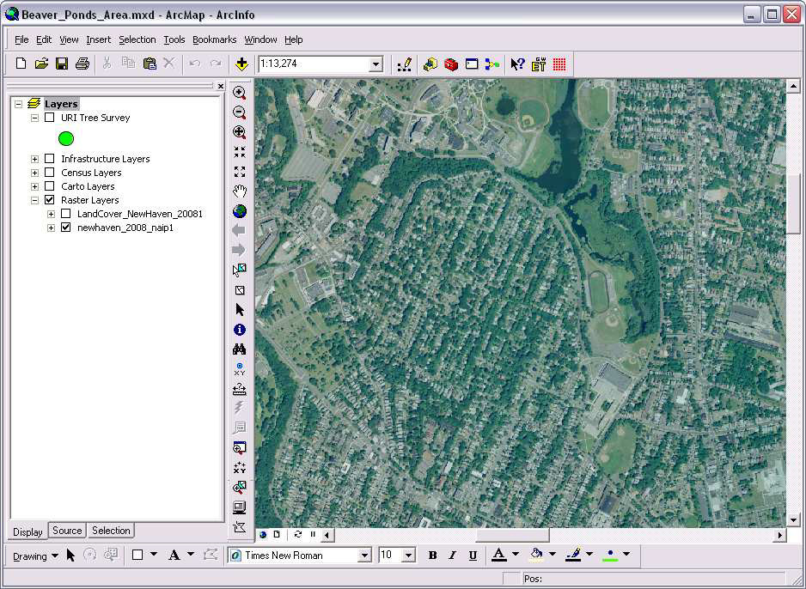

Slide 3
Basic concepts
Arc catalogue
Arc Map.
Arc Toolbox

Slide 4
Basic concepts
Arc catalogue data holdings, for managing your database designs, and for recording and viewing metadata.
Arc Map is used for all mapping and editing tasks, as well as for map-based analysis.

Slide 5
Cont.
Arc Toolbox is used for data conversion and geo processing.
Using these three applications together, you can perform any GIS task, simple to advanced, including mapping, data management, geographic analysis, data editing, and geo processing.

Slide 7
Creating shape files
Folder in ArcCatalog
Shapefiles in ArcCatalog

Slide 8
Main menue
Standard
Table of contents
Data frame
Drawing tool bar
Tools tool bar

Slide 9
Storing Data
Coverages
Shapefiles
Feature
Countries
Counties
Counties.shp
Counties.shx
Counties.dbf
ROADS
Counties.prj
Counties.sbn
Counties.sbx
Building

Slide 10
Arc Map
Arc Map lets you create and interact with maps. In Arc Map, you can view, edit, and analyze your geographic data.
You can query your spatial data to find and understand relationships among geographic features.

Slide 12
Arc Map
Display information from a database
Data Editing
Querying
Analyzing
Graphing
Reporting

Slide 13
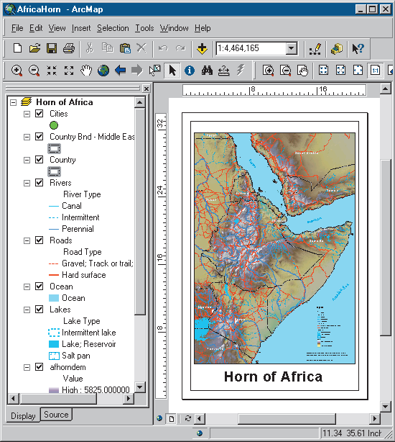
Arc Map
You can symbolize your data in a wide variety of ways.

Slide 14
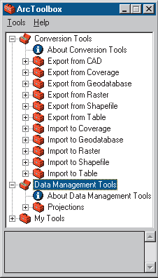
Arc Toolbox
Arc Toolbox is a simple application containing many GIS tools used for geo processing.

Slide 15
ARC MAP
Arc Map is the tool for creating, viewing, querying, editing,
composing, and publishing maps.
Most maps present several types of information about an
area at once. This map of Green valley contains three layers that show public buildings, streets, and parks.
You can see the layers in this map listed in the table of
contents. Each layer has a check box that lets you turn it on
or off.

Slide 16
Table of content
Arc Map Table of Contents
Point features
Line features
Area features

Slide 17
Zoom in and get information
If you want to see an area of the map in greater detail, you can zoom in to the map.
1. Click the Zoom In button.
2. Drag a box around one of the parks to zoom in to it.

Slide 18
Tools tool bar
Moving around the map
Zoom in or out
Pan
Full extents
Back or forward one display
Zoom to layer

Slide 19
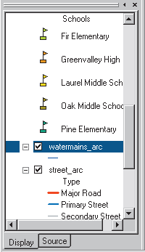
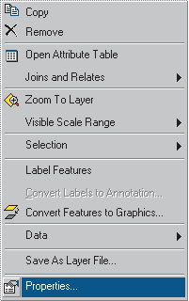
Feature properties
1. Right-click water mains arc in the Arc Map table of contents and click Properties.

Slide 20
2. Click the Symbology tab on the Properties dialog box.

Slide 21
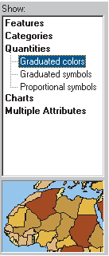
Properties
Click Quantities. The panel changes to give you controls for drawing with graduated colors

Slide 22
Click View and click Layout View.

Slide 23
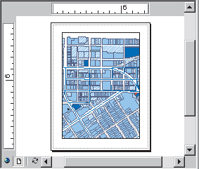
Data Frame
Now you can see the map on a virtual page. The layers of data appear in a data frame on the page. Data frames are a way of organizing the layers you want to see together on a map.

Slide 24
Add map Elements

Slide 25
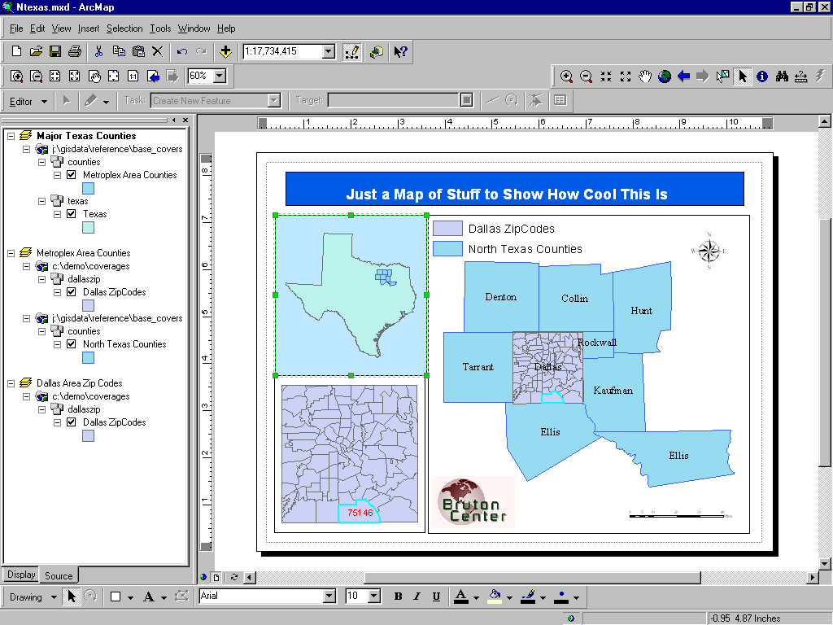
Map Data Sources

